Slide 1
college site (Techeduca)
-by pooja from bscit
Notes:
Are your classroom colors different than what you see in this template? That’s OK! Click on Design -> Variants (the down arrow) -> Pick the color scheme that works for you!
Feel free to change any “You will…” and “I will…” statements to ensure they align with your classroom procedures and rules!

Slide 2
Description :
The topic is based on college website. In the site you will see information about a particular college, like college courses, there blogs, about the college, the campus of the college, facilities which are provided. In the website you will see all Details about a college like campus area, facilities area , about the college, Blog of College, How to contact?, and Registration etc. details are mention in the site. To Make this Full site I’ll Use Html ( Hypertext Markup Language ), bootstrap, CSS (Cascading Style Sheets ), JavaScript . Html is used to make a web page and css is used to design and make interactive to page to user interface and bootstrap is used to load the icon or font in website through link, JavaScript can update and change both HTML and CSS. JavaScript can calculate, manipulate and validate data.

Slide 3
Test cause :
1. Homepage test cases :
Verify that the homepage loads correctly.
Verify that the navigation menu is easy to use and is visible on all pages.
Verify that the website loads quickly and does not have any broken images or links.
Verify that the all hover effect on the homepage works correctly.
2. About page test cases:
Verify that the about page is easy to find and navigate to from the homepage
Verify that the information about the college's history, mission, and values is accurate and up-to-date
Verify that the information about the college's leadership, faculty, and staff is accurate and up-to-date
Verify that the contact information for the college is correct
Verify that the About information in footer is correctly.

Slide 4
3. Blog page test cases:
Verify that the blog page is easy to find and navigate to from the homepage.
Verify that the blog posts are displayed correctly, with accurate dates, titles, and content.
Verify that the blog page can be shared on social media.
4. Course page test cases:
Verify that the course page is easy to find and navigate to from the homepage.
Verify that the course information is accurate and up-to-date, including course titles, descriptions.
Verify that the course information of college are load properly.
5. Contact page test cases:
Verify that the contact page is easy to find and navigate to from the homepage.
Verify that the contact form is easy to use and submits data correctly.
Verify that the location and map information is accurate and up-to-date.
Verify that the email addresses and phone numbers are clickable and can be used to contact the college.

Slide 5
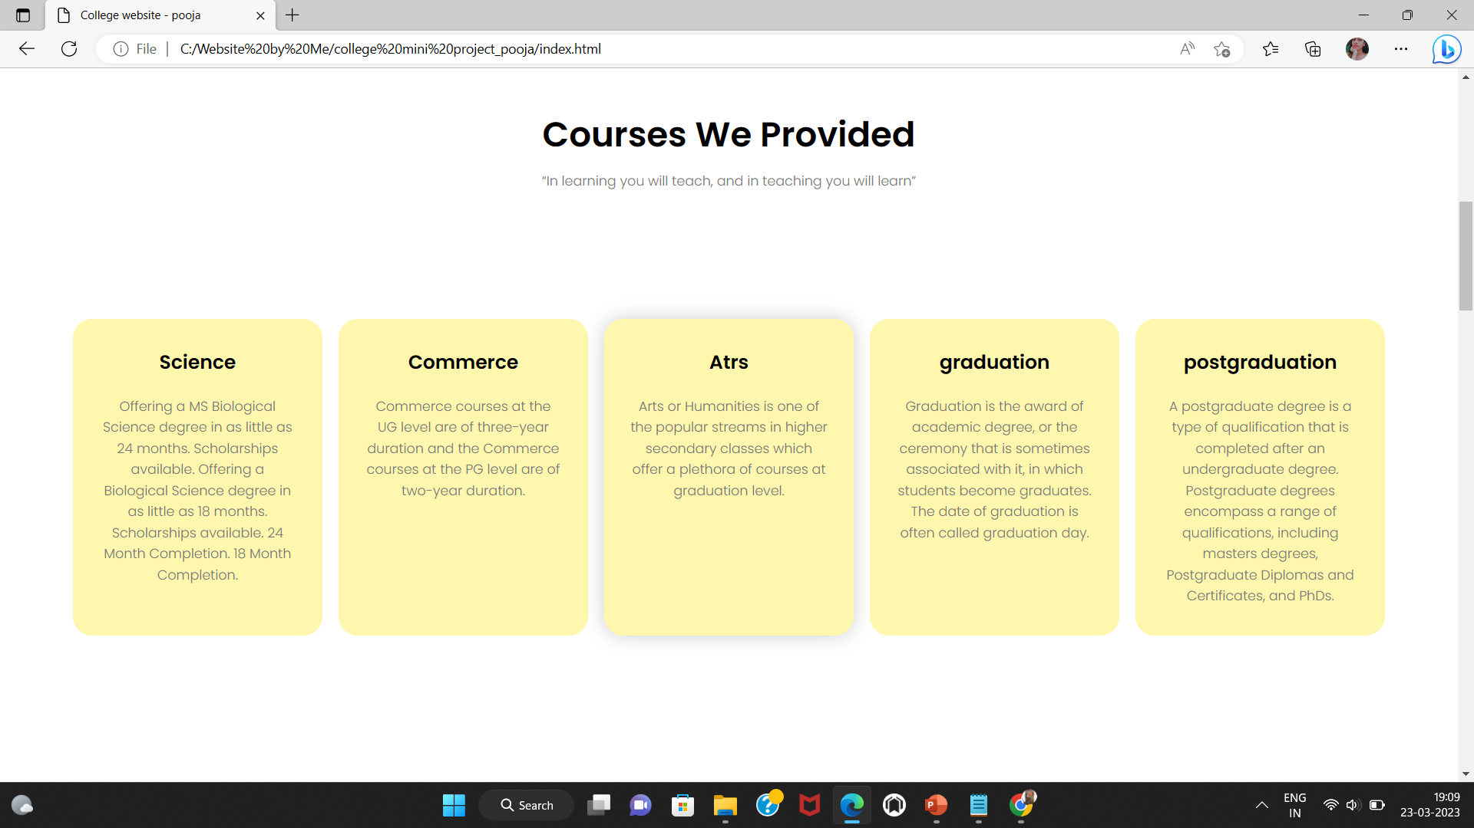
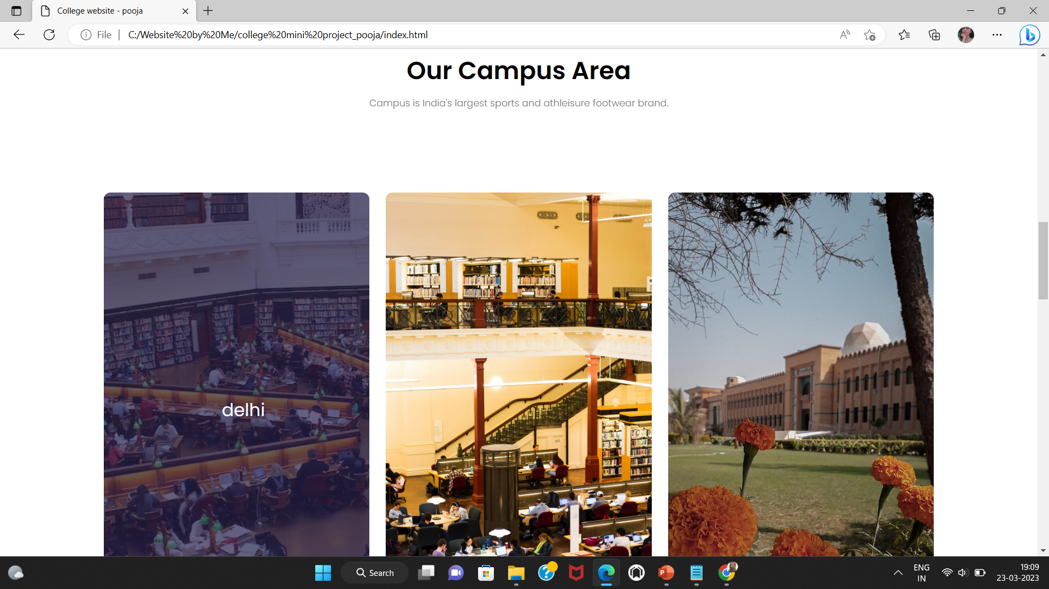
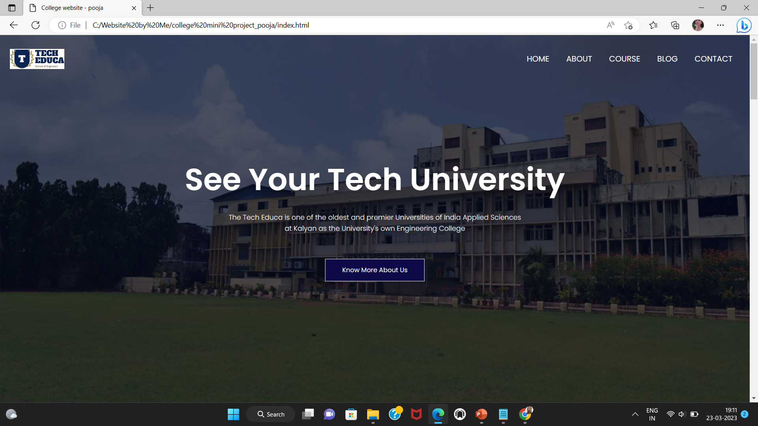
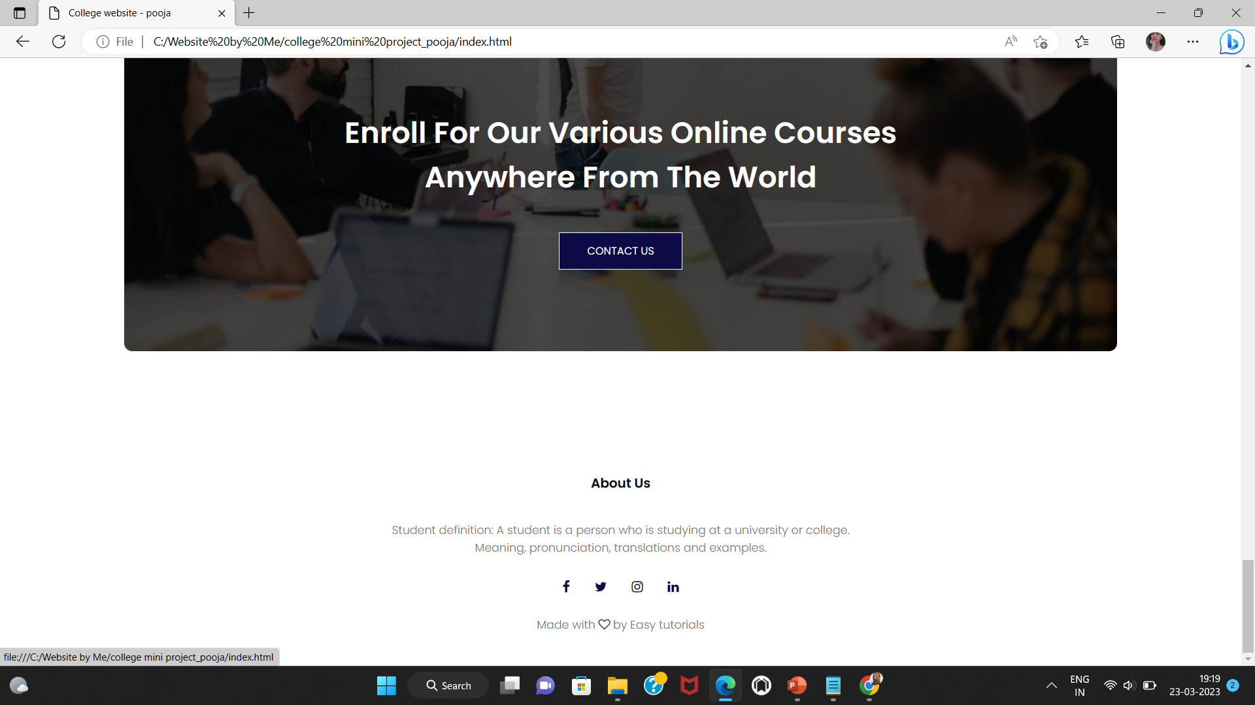
UI(user interface): Home

Slide 6
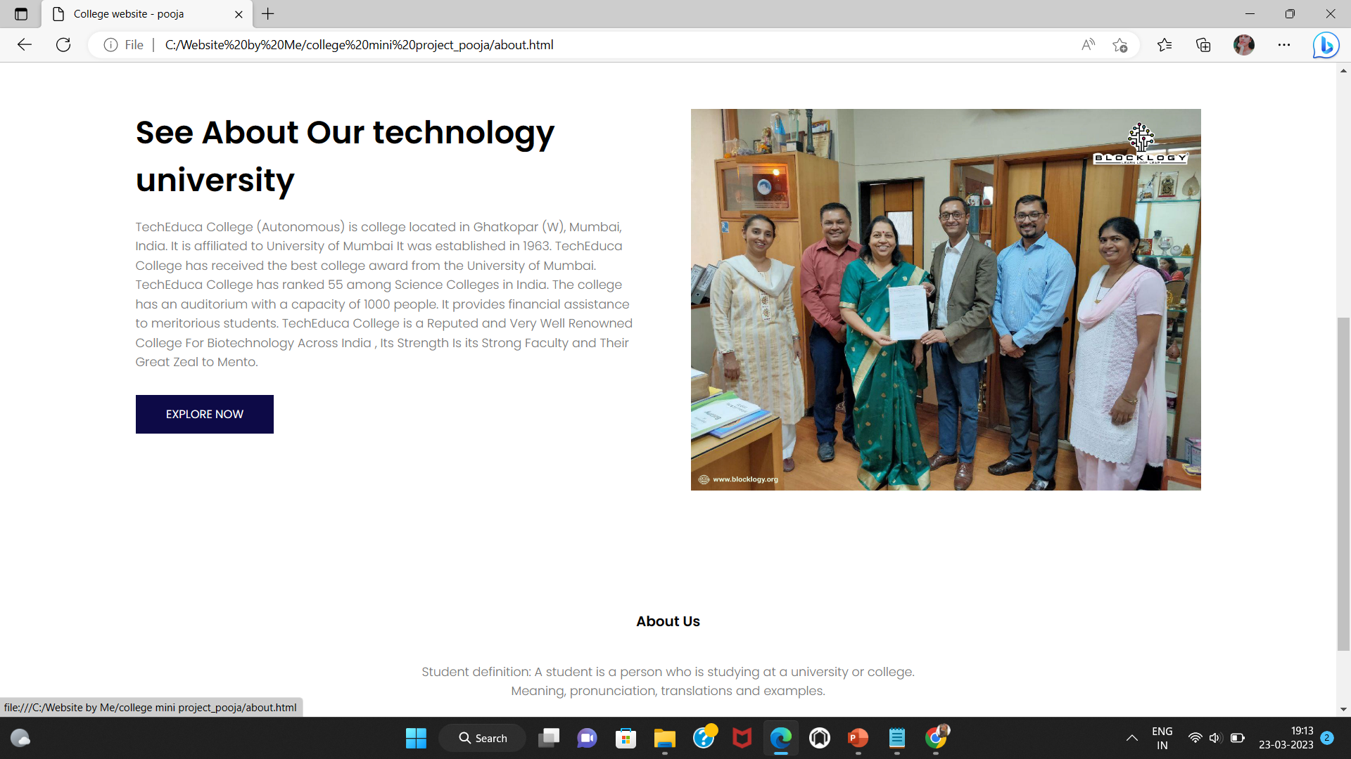
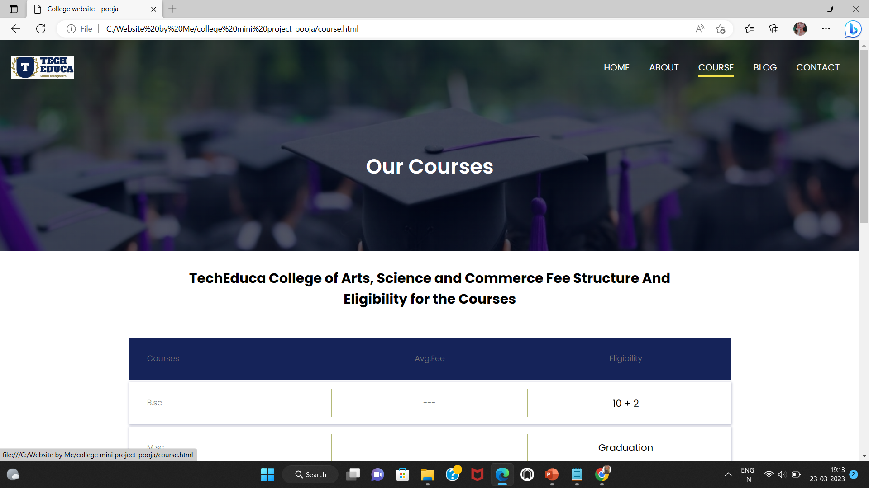
About, Course :

Slide 7
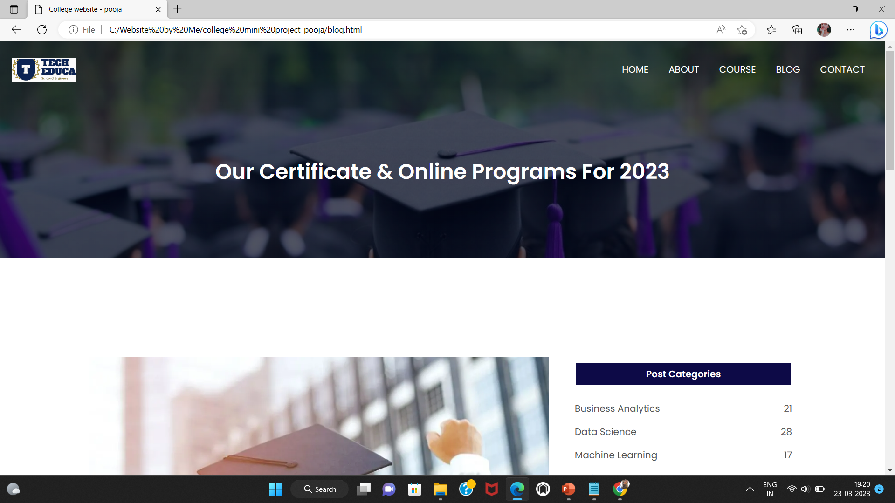
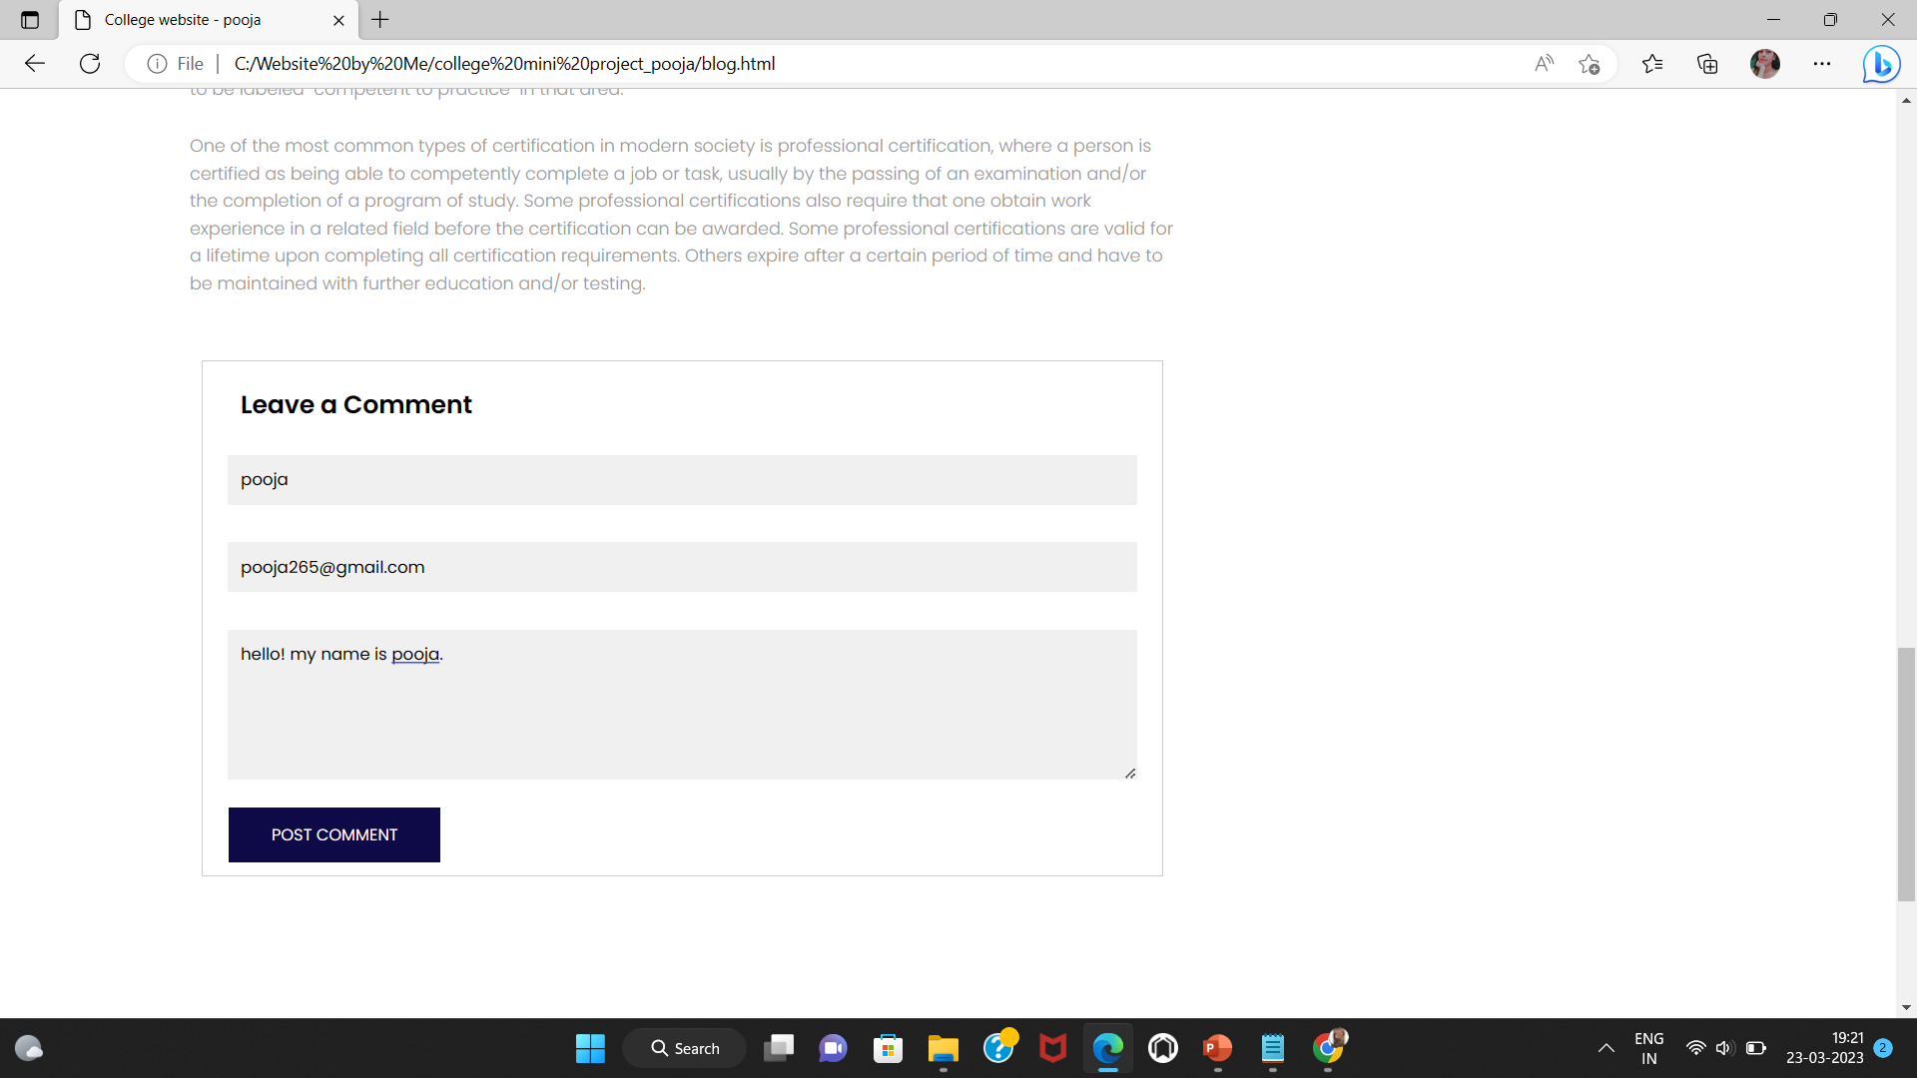
Blog :

Slide 8
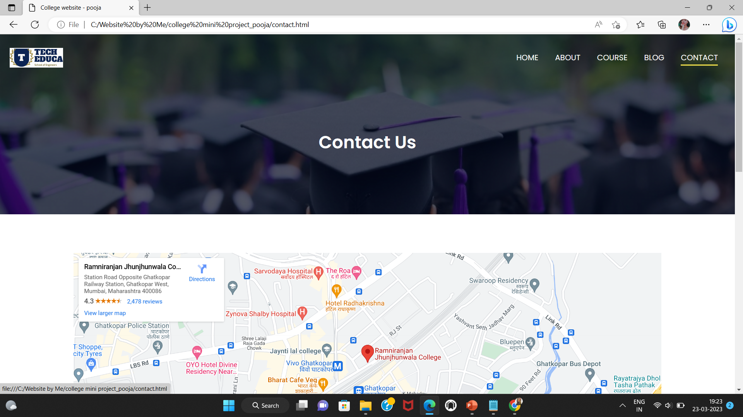
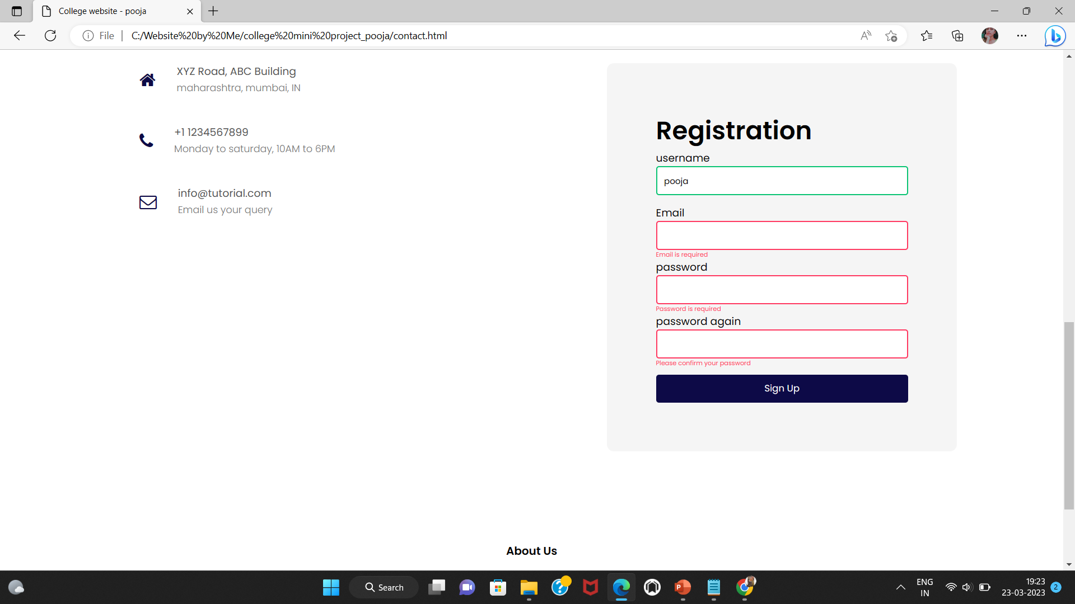
Contact :

Slide 9
Thank You……..!

